Slide 1
Ixpert
Interactive Solutions
innovation
ideas
We deliver what you require and
not what we have.

Slide 2
Ixpert –ERP

Slide 3
Overview
Ixpert – Enterprise Management System (EMS) facilitates efficient management.
The software is highly customizable according to the unique needs of
different businesses.
Developed into powerful and complex data collection programs
Interfaced with multiple functional areas of business

Slide 4
Ixpert – EMS
Process all types of accounting transactions
Transactions affecting general and special journals
Organizes transaction processing in modules
Provides links between modules
Include Accounts Receivable, Accounts Payable, Inventory

Slide 5
Finance
Complete financial accounting including:
General Ledger
Cash & Bank
Profit & Loss
Balance Sheet
Bank Reconciliation
PDC’s
Check Bounce etc.

Slide 6
Cash & Bank
Collections and Payments
Auto Cash Sweep In
Cheque Bounce
Cheque Status Update
Cheque Cancellations
Fund Transfer

Slide 7
Bank Reconciliation
Upload Bank Statement
Auto updates Cheque cleared / un cleared
For multiple branches
Clearance Cheque no wise

Slide 8
Purchase
Complete Purchase modules to help you in tracking your sales right from the enquiry generation. The software captures all the details from enquiry generation to collection against the invoice raised. It has the following screens:
Purchase Indent
Purchase Order
Material Receipts / Goods Receipts Note
Purchase Invoice
Purchase Return
Quotations

Slide 9
Sales
Complete Sales module with workflow to help you in tracking your sales right from the order generation. The software captures all the details from order generation to collection against the invoice raised. It has the following screens:
Sales Order (with Variance levels)
Delivery Note / Challan
Sales Invoice
Sales Return
Quotations

Slide 10
Multiple Pricing Levels
Normal List price
Multiple sales prices
Customer price discount
Volume discount pricing

Slide 11
Inventory Controls
Maintains sales, costs of goods and inventory ledgers
Inventory depletion based on sales
Inventory usage forecast capability
Create, review, & edit purchase orders
Track historical inventory purchase
Create barcode labels from inventory
Inventory list triggered by inventory
level falling below pre-defined norms batchwise
Sales and Purchase tracked batch-wise
, expiry date wise and price wise
Track down all items in a batch even after distribution

Slide 12
Inventory Attributes
The software captures the detailed information of the products with multiple attributes:
Batches (with manufacturing and expiry date)
Brand
∗
∗
∗
∗
∗
Category
Size
Variant
Multiple Unit of Measure
Multiple Pricelist Batch Number Expiry Date
Brand
Size
Catego
ry
Product
Flavor
Variant

Slide 13
Inventory
Inter Branch Transfers
Stock Requisition from branch
Stock Transfer to Branch
Stock Received from Branch
Inventory Adjustments
Shortages
Excesses
Internal Consumption
Track products batch wise
Track products with batch and expiry date

Slide 14
Manufacturing
Define BOM/Recipes
Multiple Processes
Routing chart definition- output from one process is input for next process
Work Orders
Issue to and receipt from Production
Each stage track Output, By-product and Scrap
By-products may be re-worked or scrapped
Workers Scheduling
Batch Number
Expiry Date

Slide 15
Job Work
Job Work Management
Issue for Job Work (QC approved Raw Material only if needed)
Return from Job Work
QC before acceptance
Approved, Rejected and Re-Work
Tracking of goods with each Job Worker
Parallel processes In-house production and Job Work

Slide 16
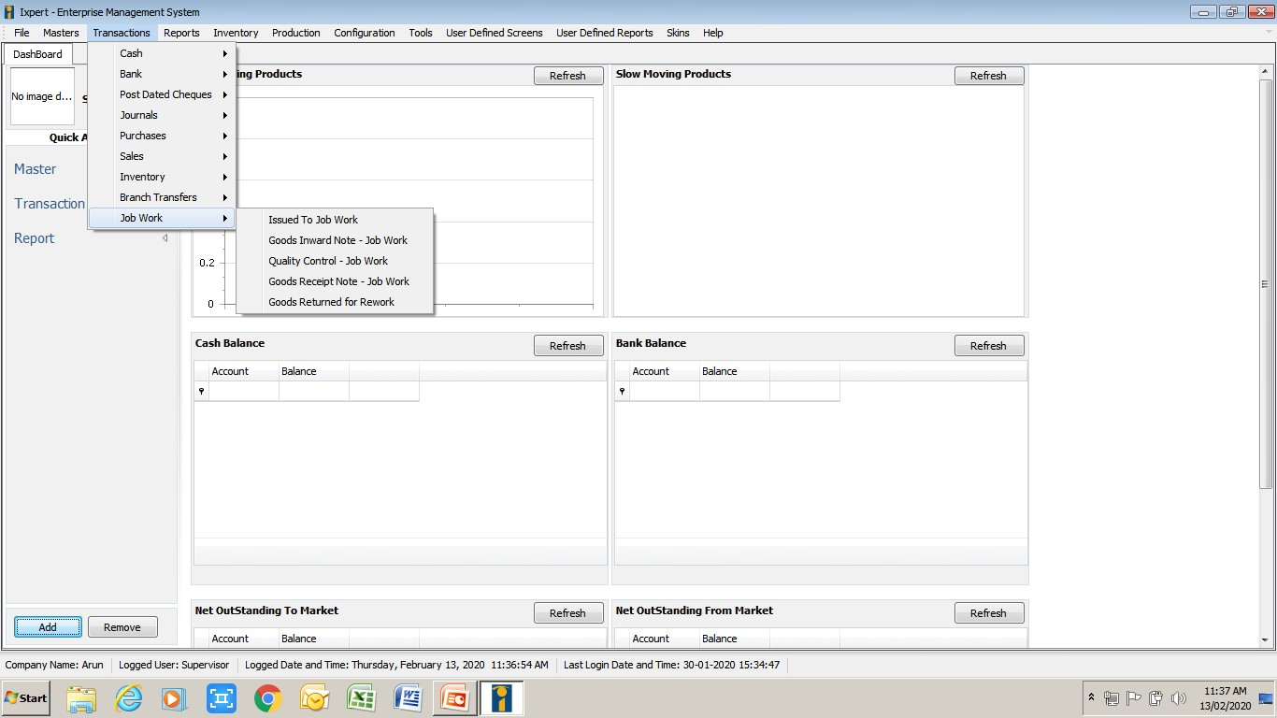
Job Work

Slide 17
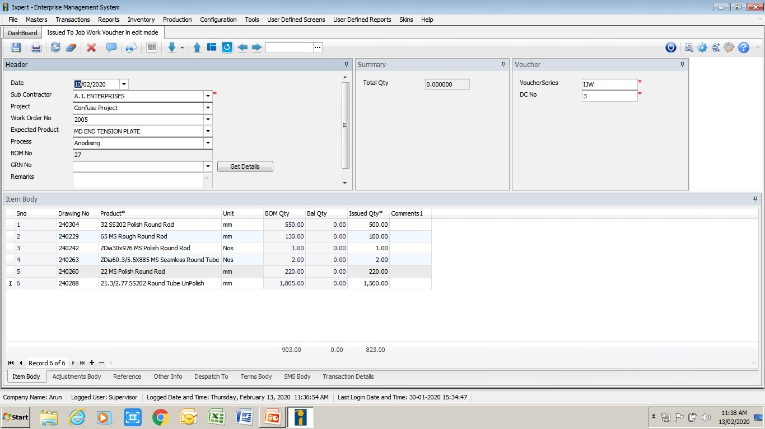
Issue to Job Work

Slide 18
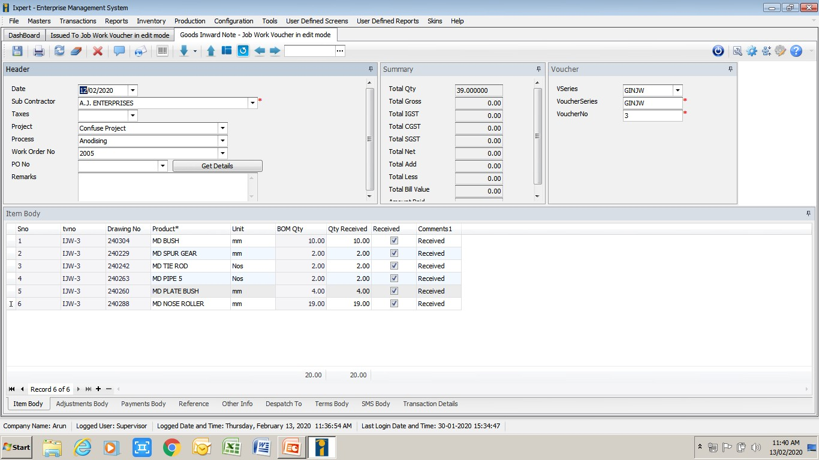
GIN return from Job Work

Slide 19
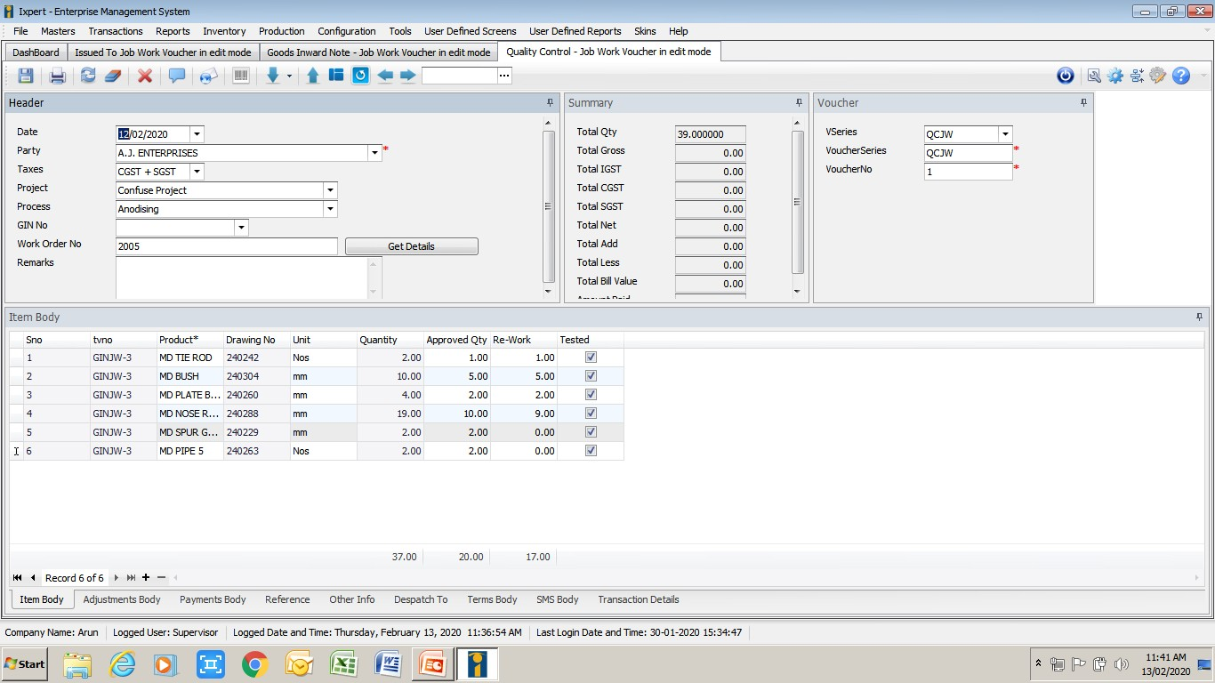
Quality Control - Job Work

Slide 20
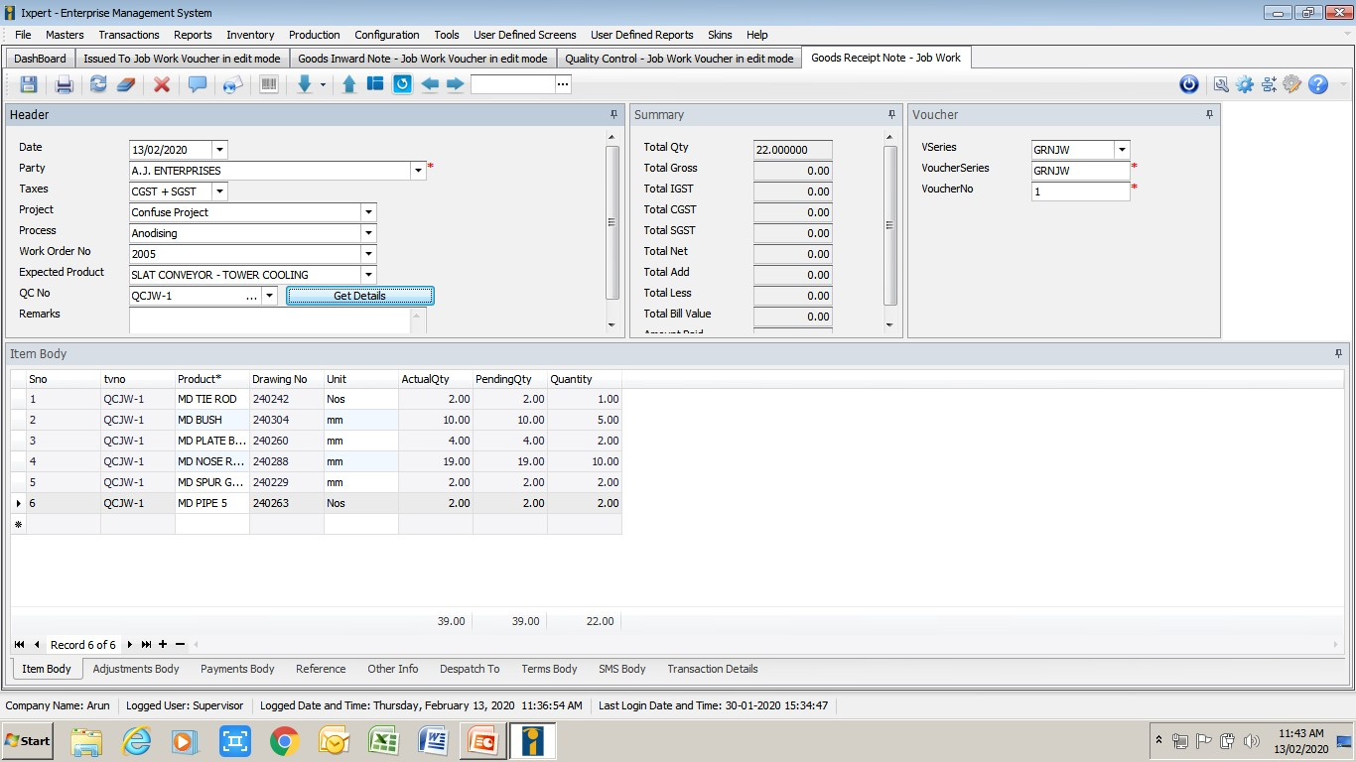
Goods Receipt Note (GRN)- Job Work

Slide 21
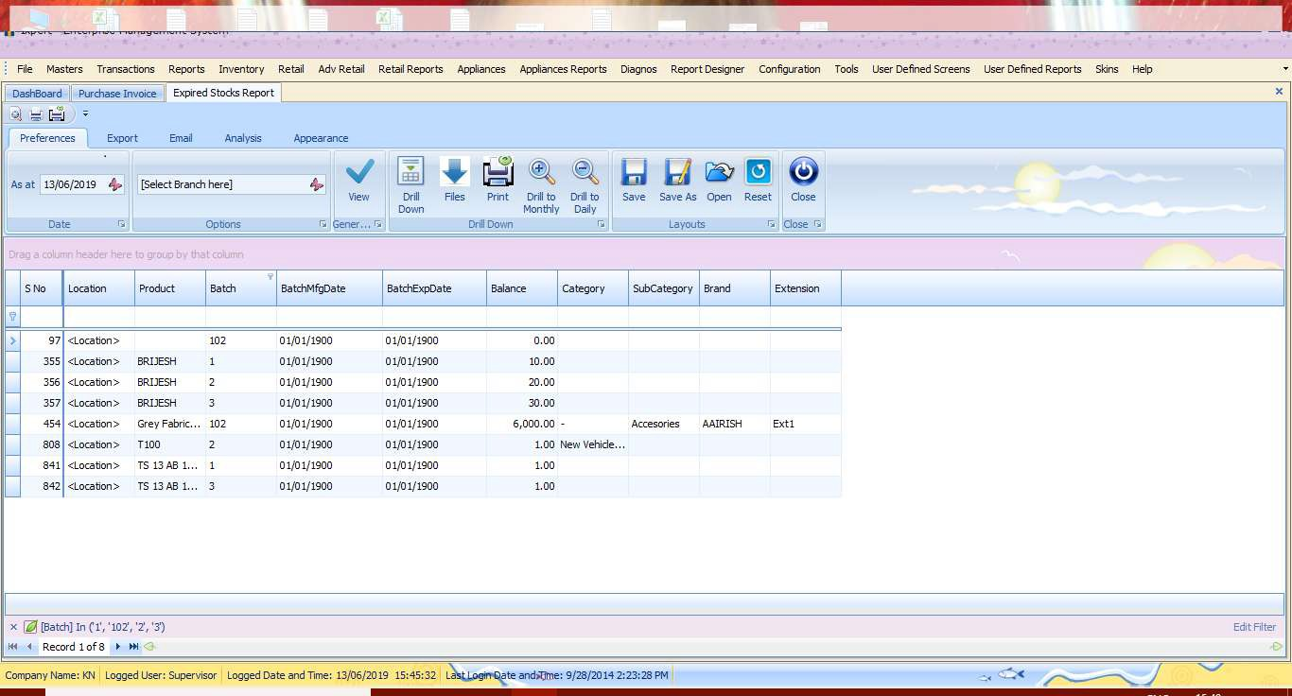
Expired Goods Report

Slide 22
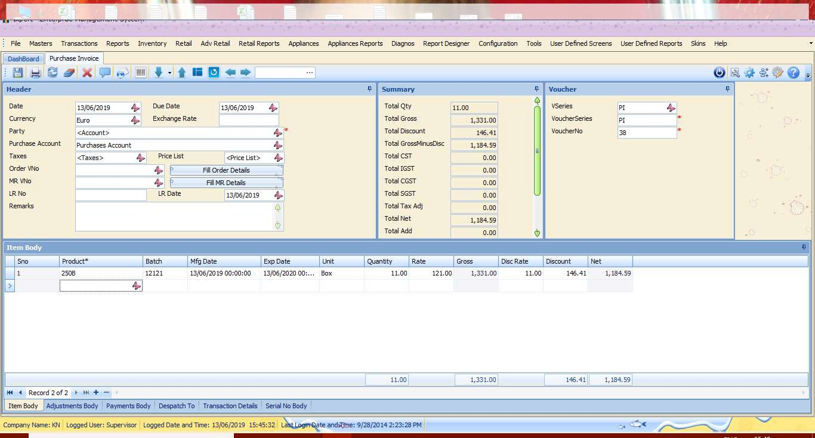
Purchase Invoice with Batch Details

Slide 23
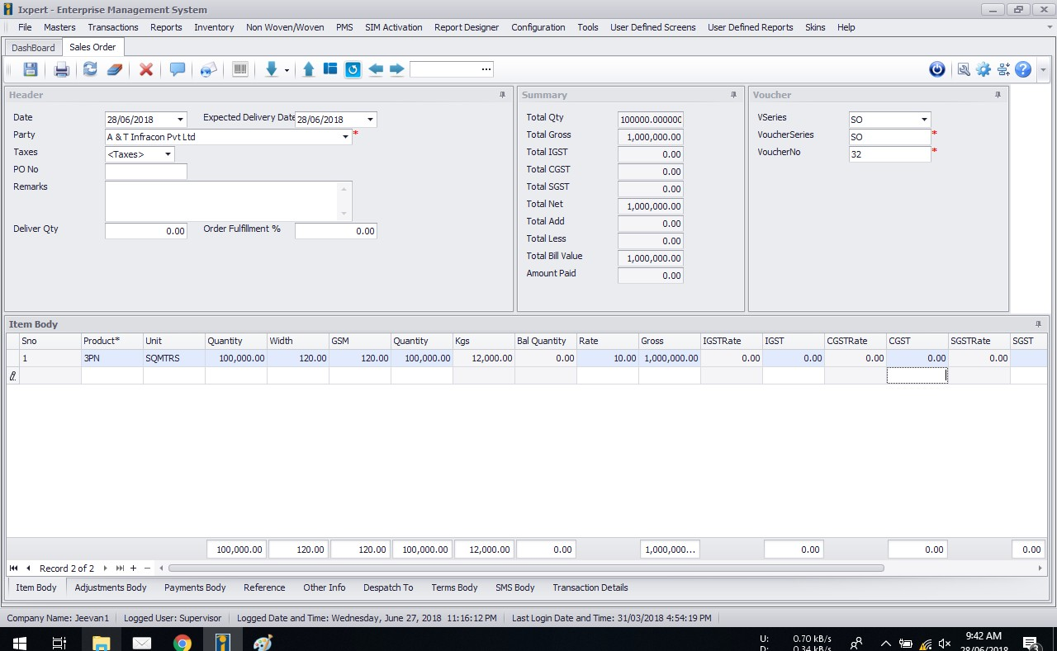
Sales Order

Slide 24
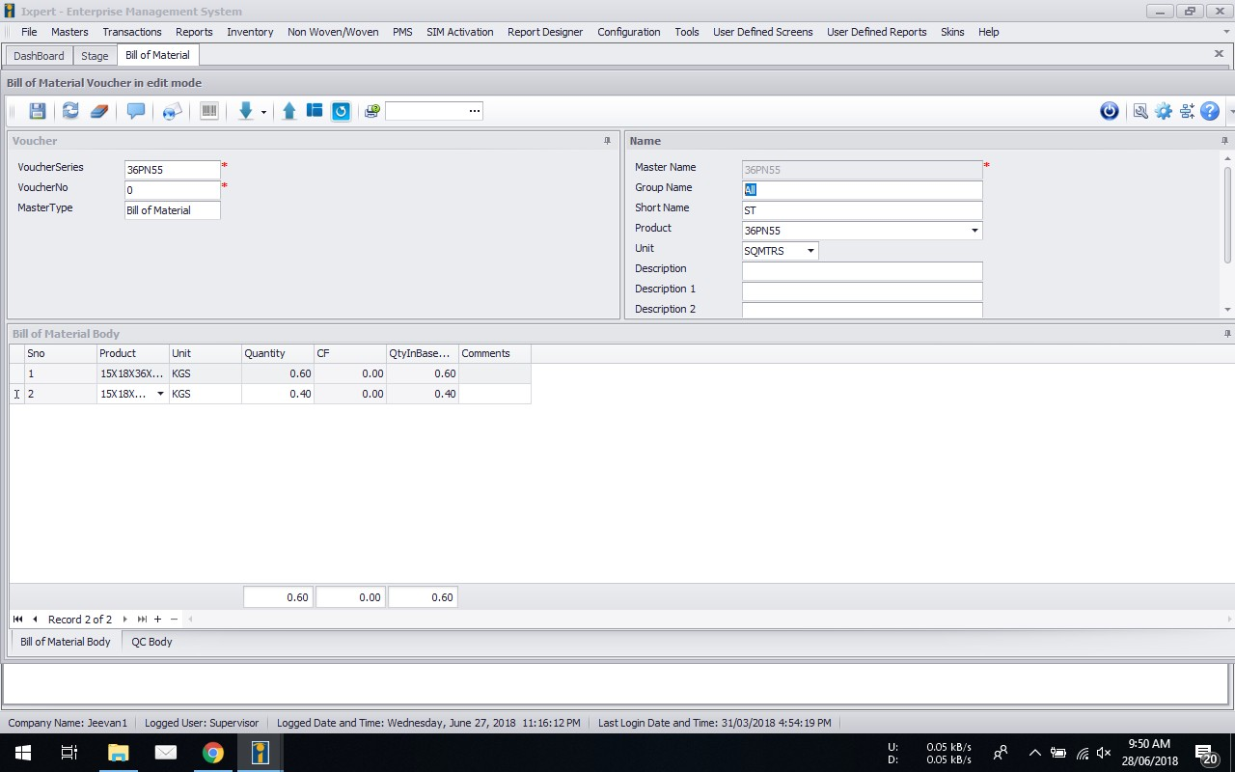
Bill of Material/Recipe

Slide 25
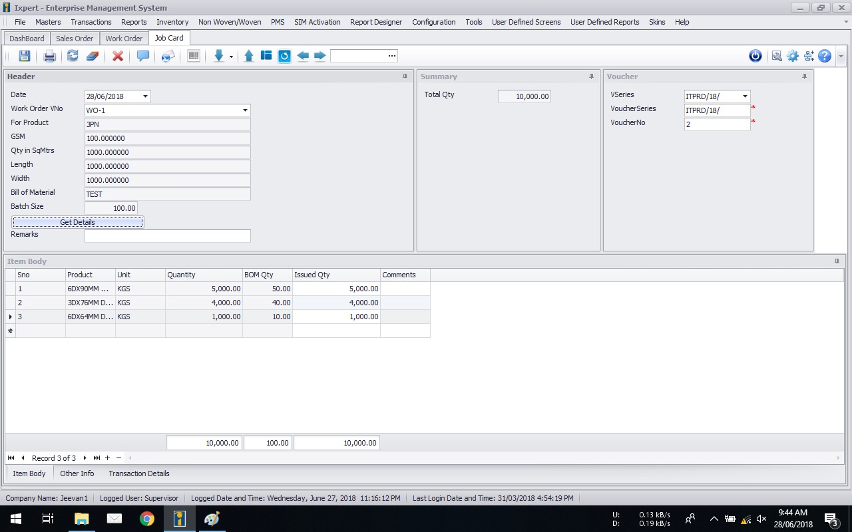
Job Card

Slide 26
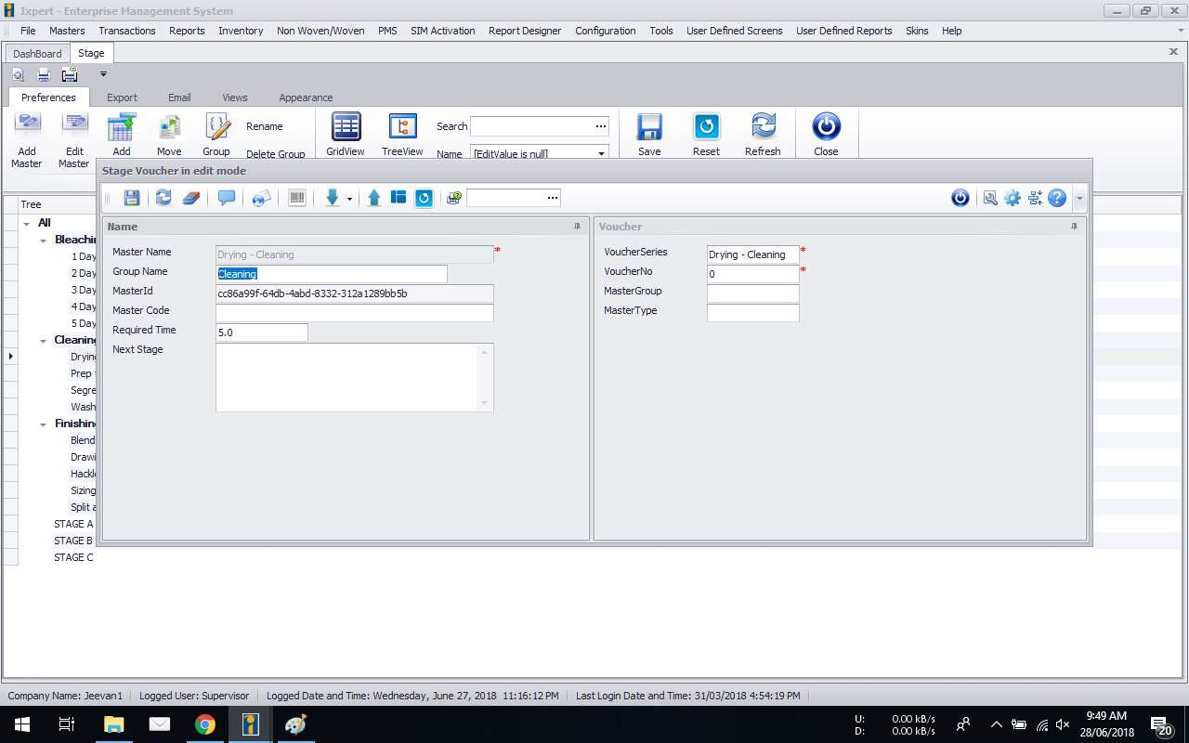
Routing Chart

Slide 27
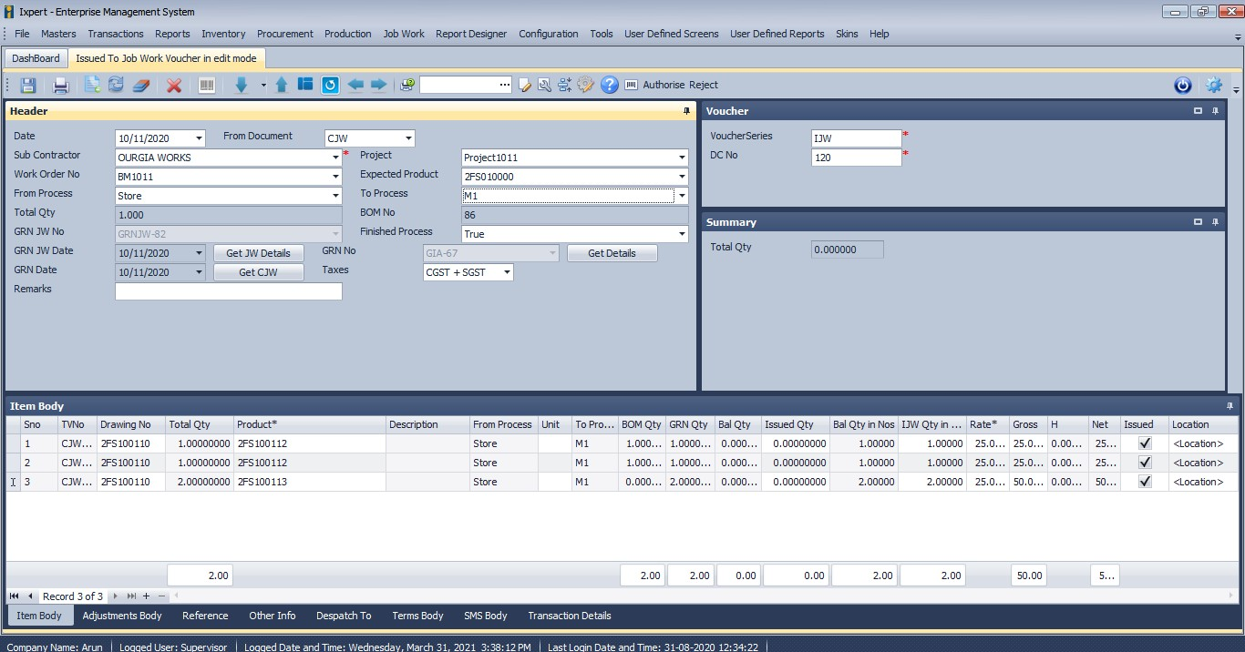
Issue from Process to Process

Slide 28
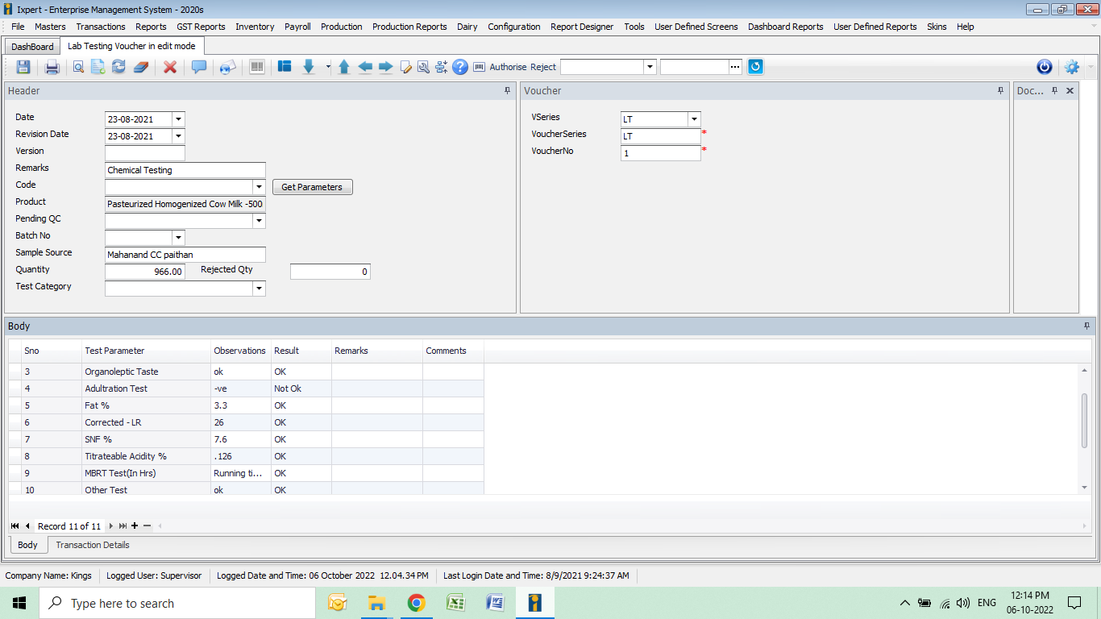
Lab Testing Screen

Slide 29
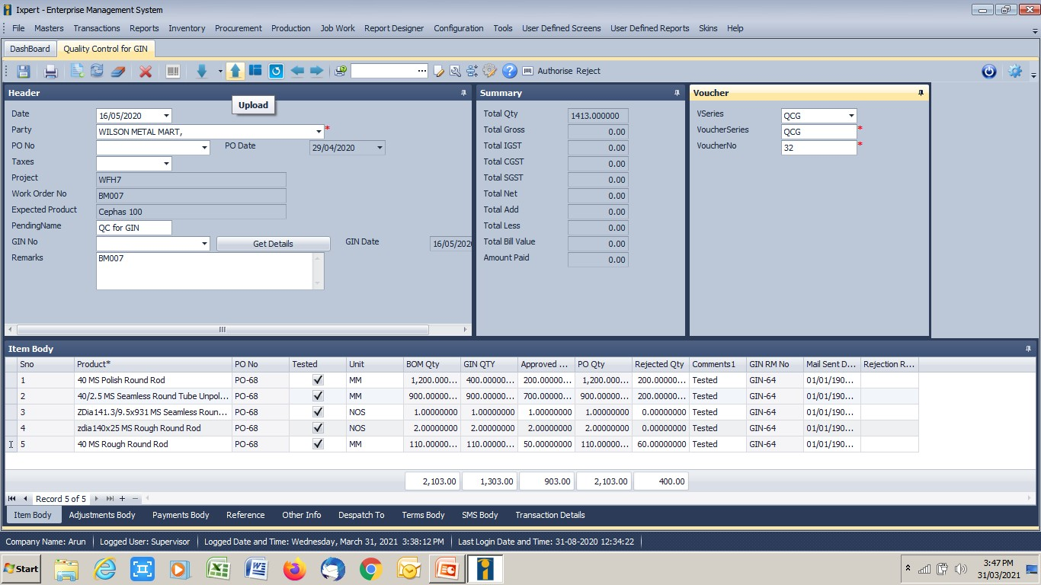
QC Screen

Slide 30
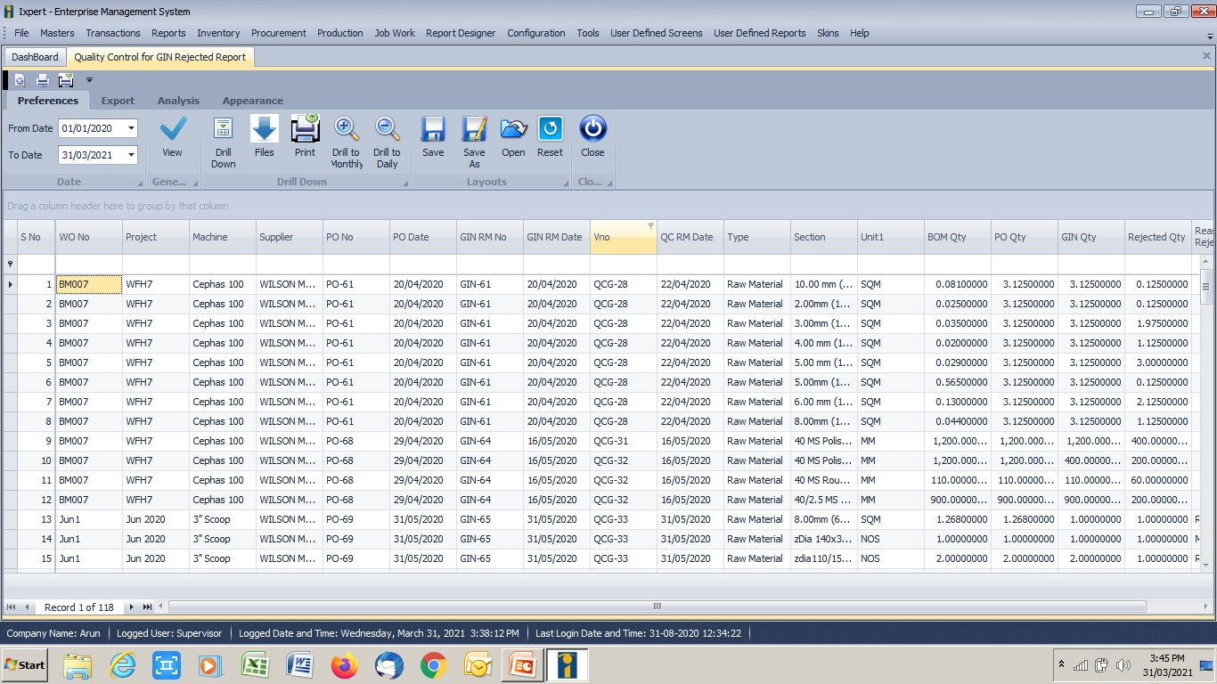
QC Rejected Report

Slide 31
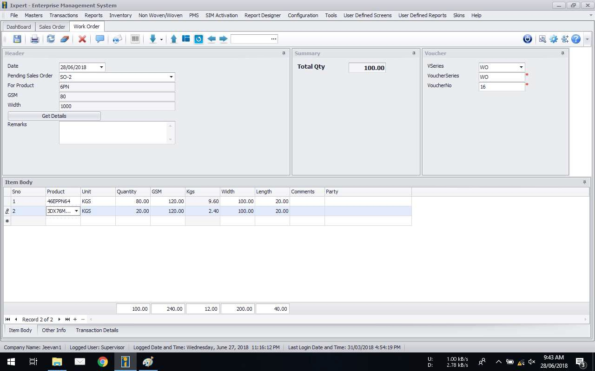
Work Order

Slide 32
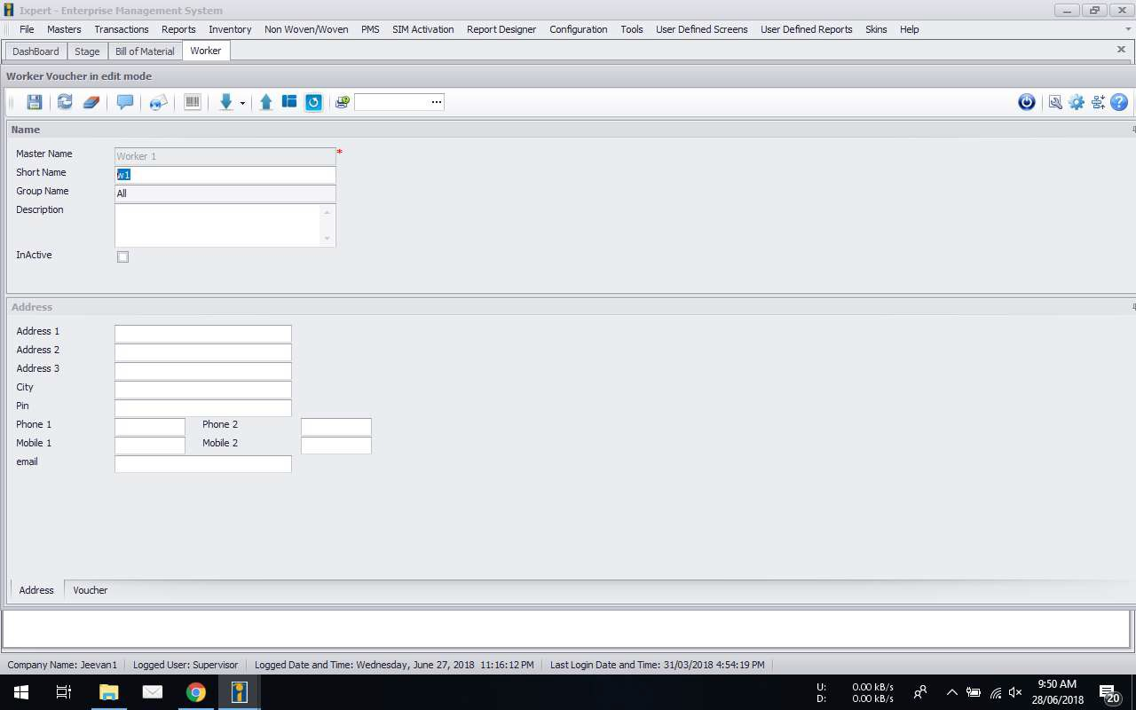
Define Labourers

Slide 33
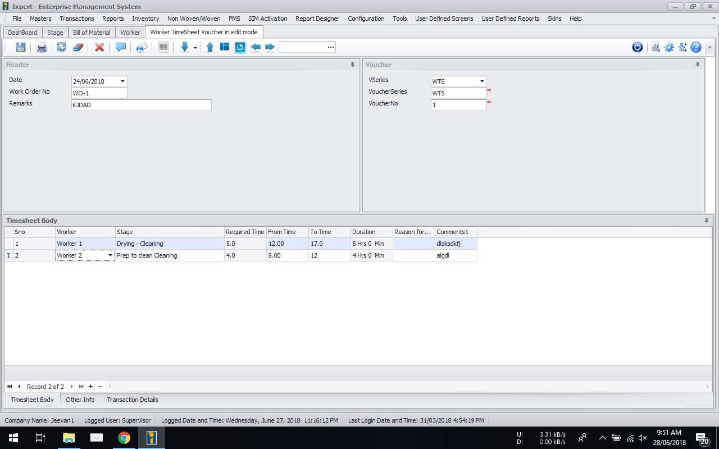
Workers Timesheet

Slide 34
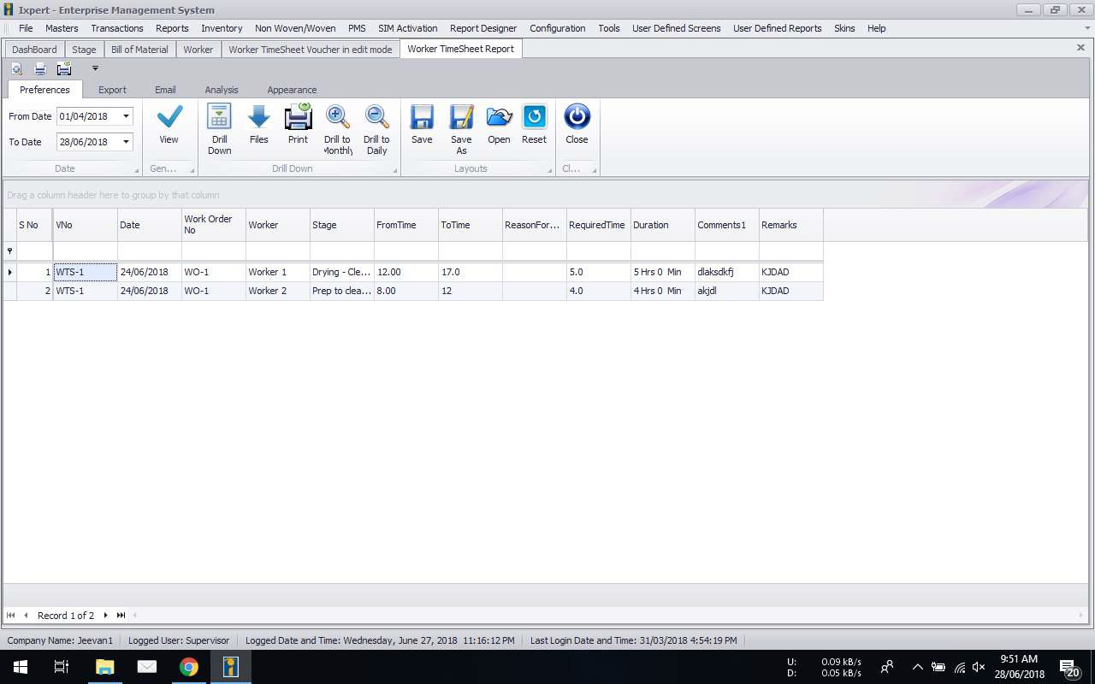
Workers Timesheet Report

Slide 35
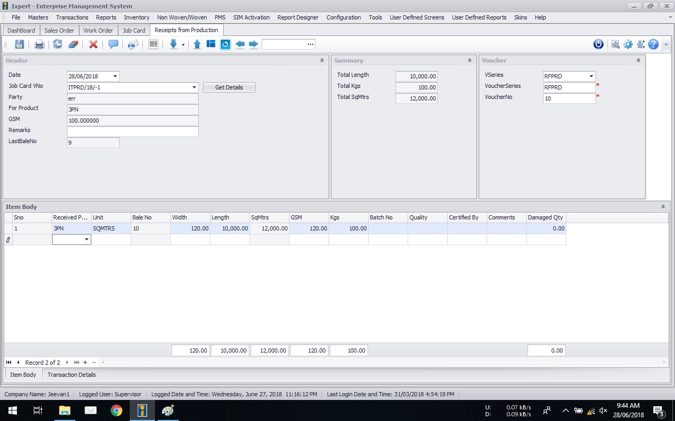
Receipt from Production

Slide 36
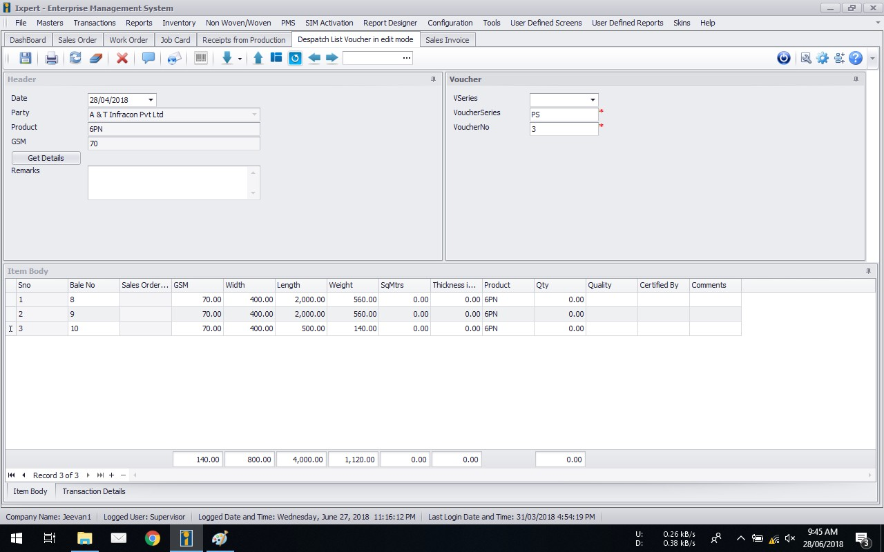
Despatch List

Slide 37
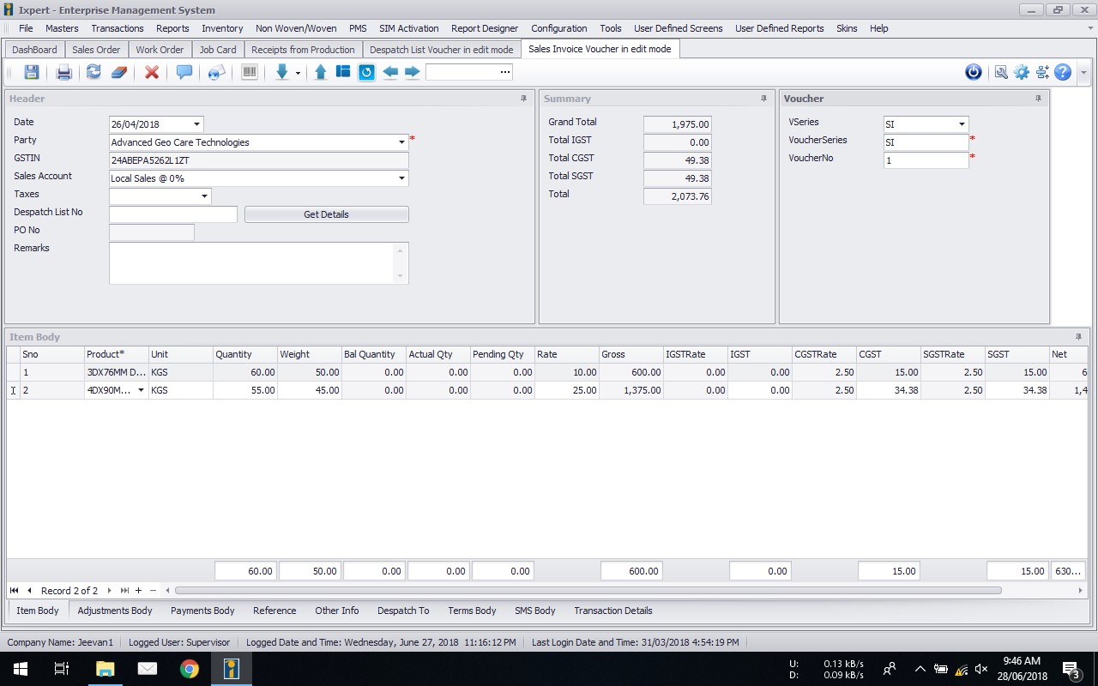
Sales Invoice

Slide 38
Taxes
Complete Tax, flexible to work in any country
GST definition, returns filing
SGST/CGST or IGST automated selection
HSN Codes tracking
Service Tax
Inclusive and Exclusive Taxes
TDS
Tax Registers
Reports for Statutory Returns

Slide 39
Segments
Supports Multiple Segments
Branch
Location
Department
Division
Cost Centre
Profit Centre
Project

Slide 40
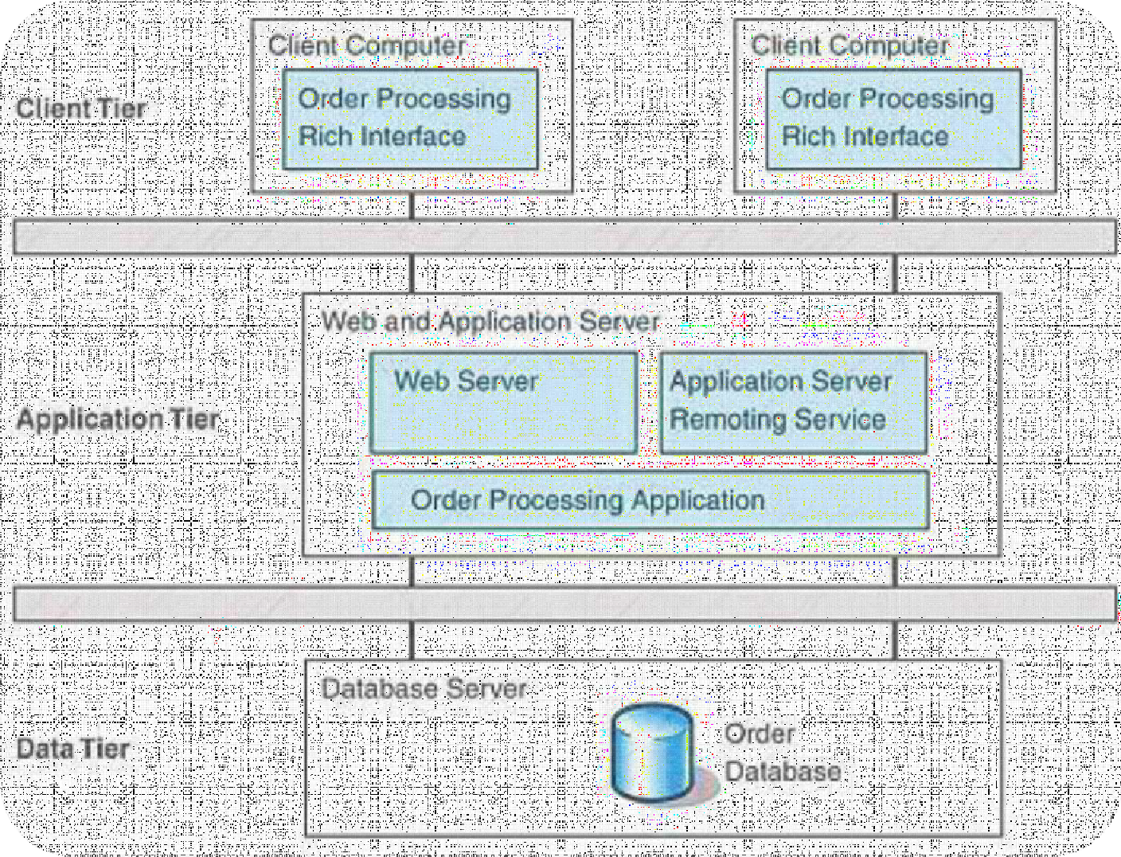
Ixpert – EMS (Architecture)

Slide 41
Centralized Database
Installed with the client’s server
Each data item stored once
Prevents data redundancy
Data immediately available to all business functions in real-time

Slide 42
Technology
Application
.NET 3 / 4; SOA, Web services, XML/SOAP/C#
Silverlight
Database
MS SQL Server 2005 / 2008
MS SQL Server Express (bundled)
Application / Web Server
IIS

Slide 43
Features
Screens Customization
Flexible Reports
Forms Designer
Label Designer
Graphs
Slice and Dice of data
User Defined Shortcuts
User Rights Management
Bar Codes
Dash Board
Credit Norms
Inventory Norms
Alerts
Audit Trail
and many more……..

Slide 44
Integrations
MS Office
Peripheral
SMS
3rd party tools
Other ERP’s

Slide 45
Screens Customization
Change column positions
Choose colours for each screen
Rename captions
Change column properties
Hide
Unhide
Read only
Required

Slide 46
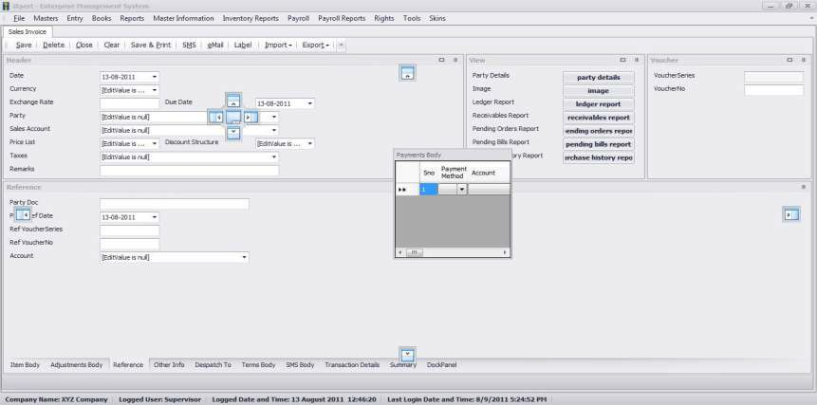
Docking of Screens
The user can dock the screens and menu according to their ease of access.

Slide 47
Reporting Tool
Flexi Reports
Design reports by query
Split Reports
Change column properties
Filter Data
Sorting Columns
Positions
∗ Size
Formulae
Add Columns
Hide Columns

Slide 48
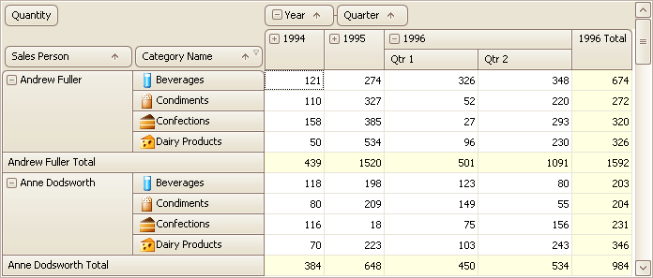
Slice and Dice Data
No need for the user to export the data to excel for pivot report
Software has inbuilt pivot rules in all the reports

Slide 49
Auto Filter
The software has auto filtering option in all the reports which make filtering of data easy for the user

Slide 50
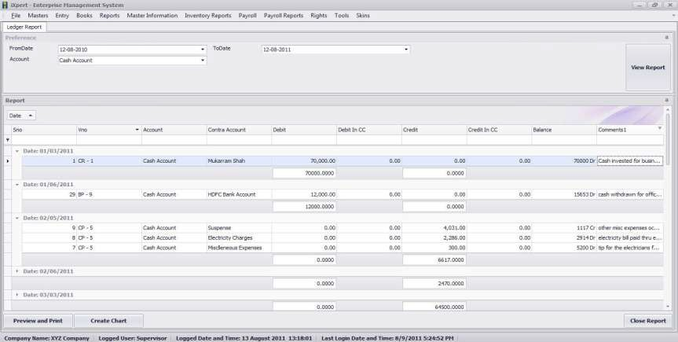
Grouping
The user needs to drag and drop the columns for viewing the group
reports

Slide 51
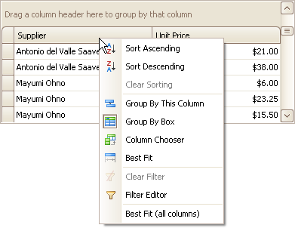
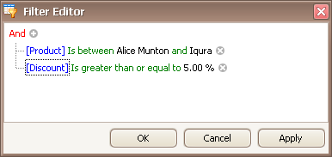
Other Additional Options

Slide 52
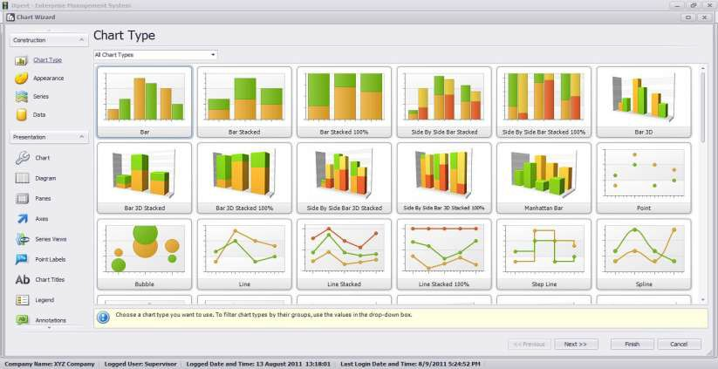
Graphs / Charts

Slide 53
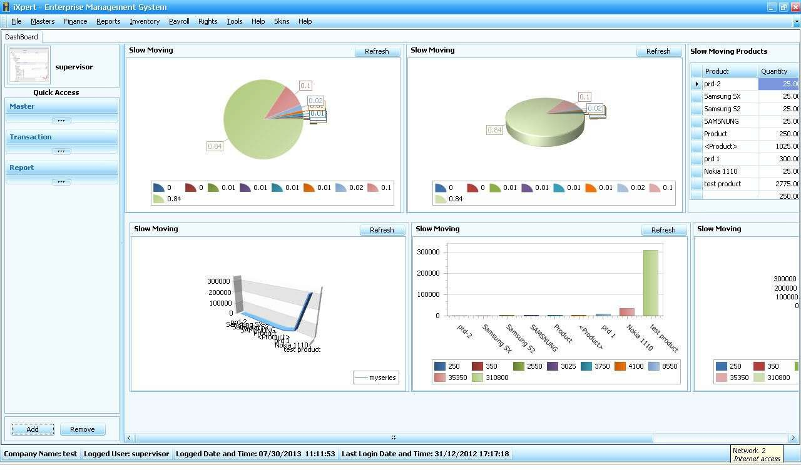
Dashboard

Slide 54
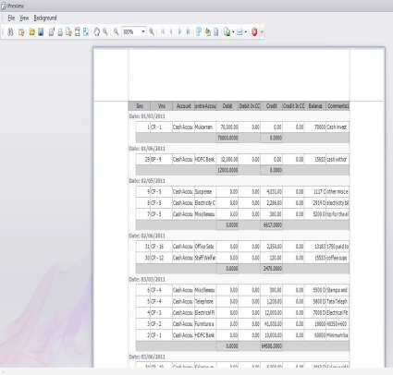
Printing Tool
This is a very powerful printing tool, which allows the user to view the exact data which will be printed. Apart from this the tool will allow the user to export the data to excel, pdf, html, xml, csv etc.
It also allows the user to send
mail directly from the application.

Slide 55
Document / Forms Designer
Supports three types of printing
Draft
Graphical
Roll
User defined unlimited number of designs for each screen

Slide 56
Labels Designer
Design Labels from/for any given report with user defined options for Number of copies and layouts as:
Address Labels
Barcode Labels
Id Cards
Pay-slips etc.

Slide 57
SMS Integration
User defined SMS from screens and reports as :
Order Confirmation
Dispatch of goods
Receivables due
Salary deposited etc.
Data population from SMS
Data Response from SMS (send sms to know your client balance, product balance etc.)

Slide 58
Peripherals Support
Serial port and keyboard scanners for barcode reading
Pole display
Weighing scale reading
Card Reader etc.

Slide 59
Thank You!

